Slide 1
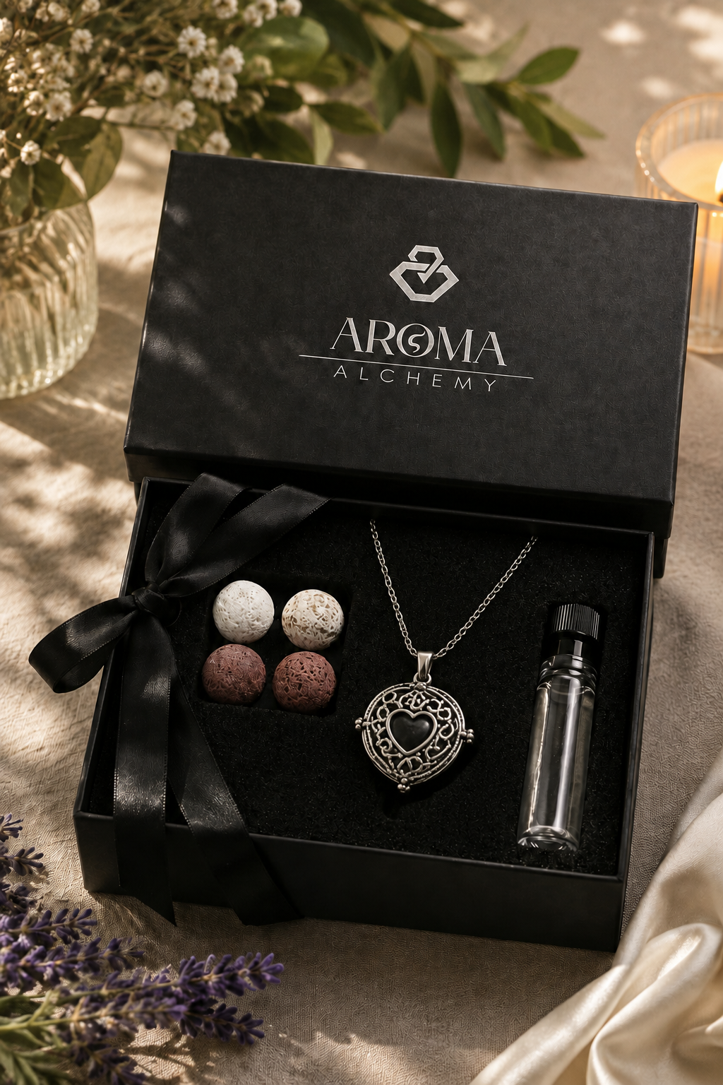
Aroma Alchemy
Wellness in every whiff.

Slide 2
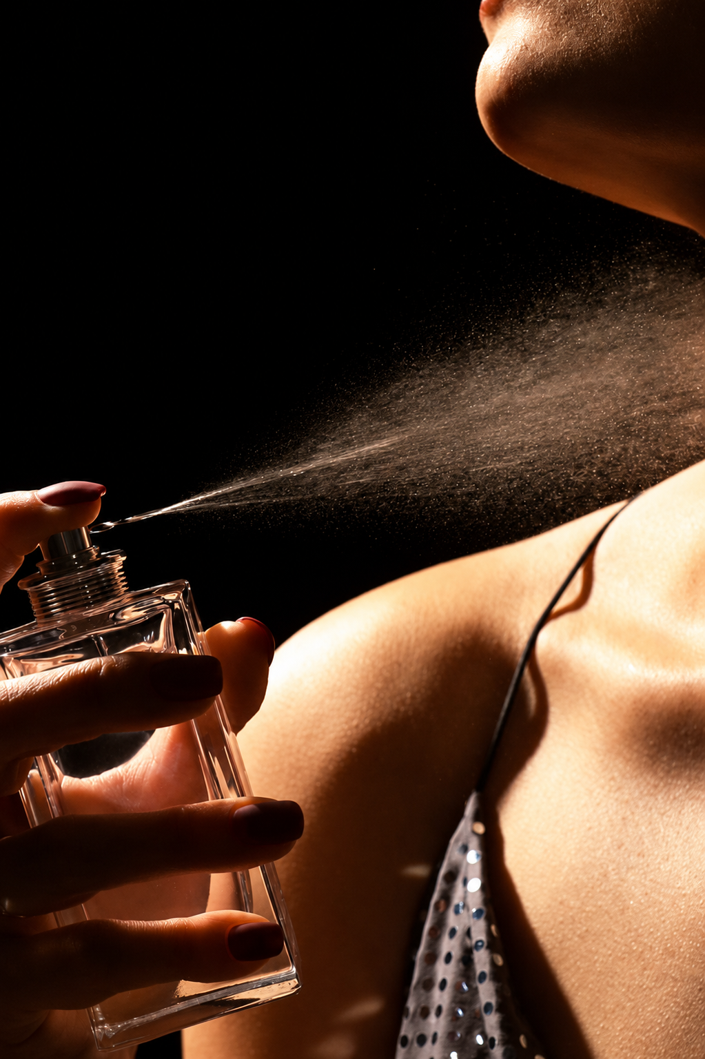

What if smelling good didn't have to hurt?
Millions avoid traditional perfumes — they trigger asthma, irritate sensitive skin, or spark allergic reactions. But everyone deserves to feel fresh, confident, and calm.
Introducing Aroma Alchemy. A new way to experience fragrance.

Slide 3




The Problem
Perfume isn't made for everyone. For millions, alcohol-based fragrances cause real harm — and instead of enjoying scent, they avoid it altogether. 32% of people experience adverse health effects from fragranced products.
Asthma Attacks
Skin Irritation
Chemical compounds trigger respiratory distress
Alcohol and synthetic ingredients cause redness and burning
Allergic Reactions
Stain on clothes
Fragrance is among the top contact allergens worldwide
Leaves visible marks on fabrics, making clothes harder to clean.

Slide 4
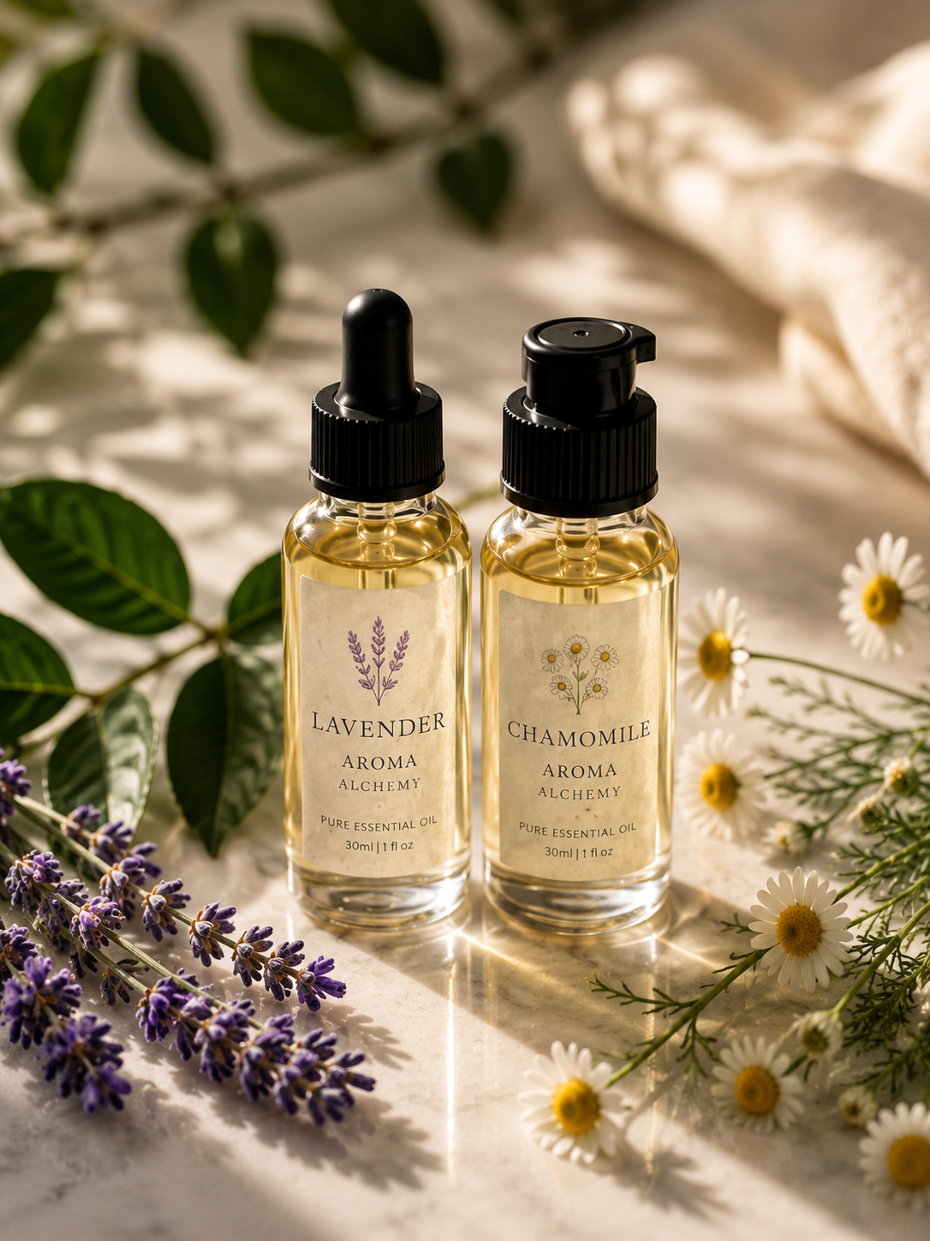
There Has to Be a Better Way.
Feeling Comfortable
No irritation. No allergies. No compromise.
Smelling Beautiful
Confident. Calm. Unforgettable.
That's the gap Aroma Alchemy was created to fill.

Slide 5
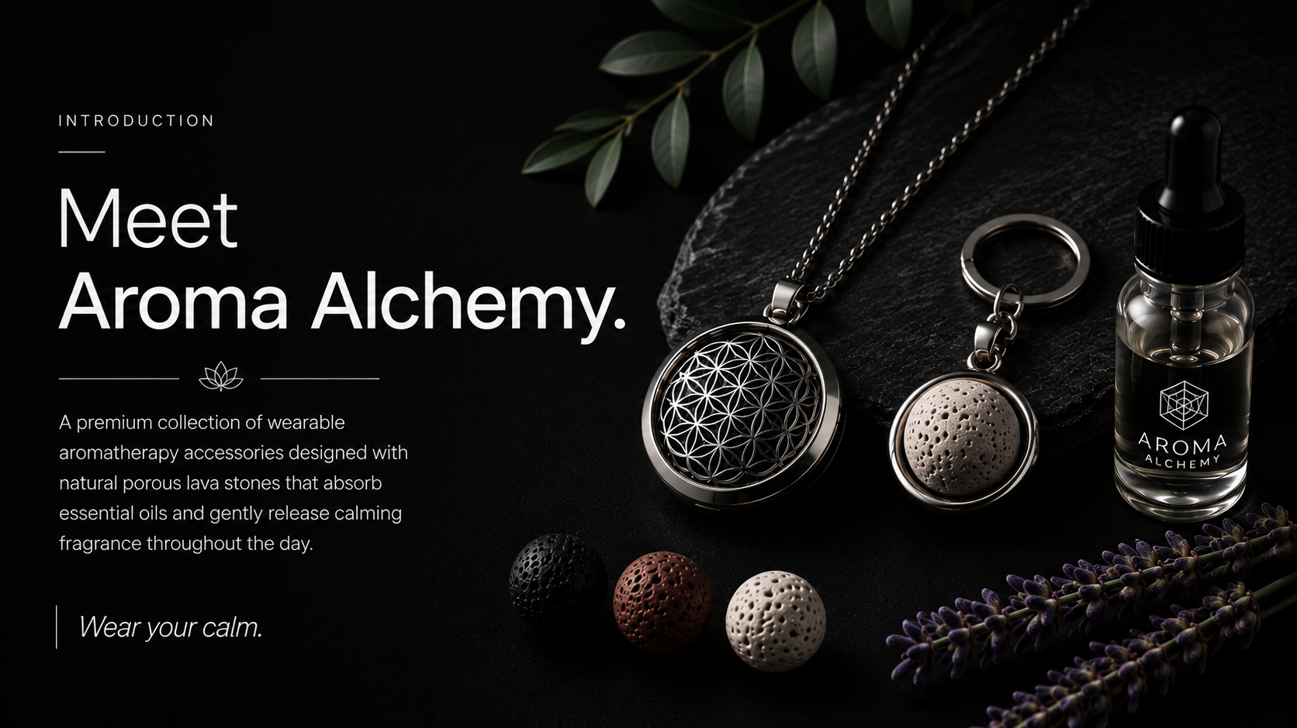

Slide 6
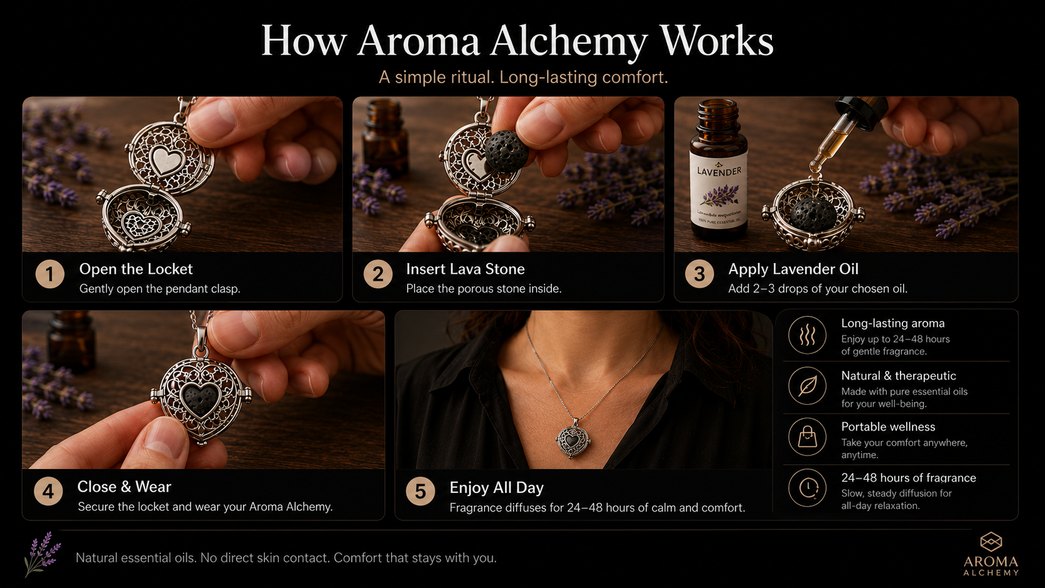
Stone Absorbs
Diffuses Hours
Add Drops
Enjoy Aroma

Slide 7
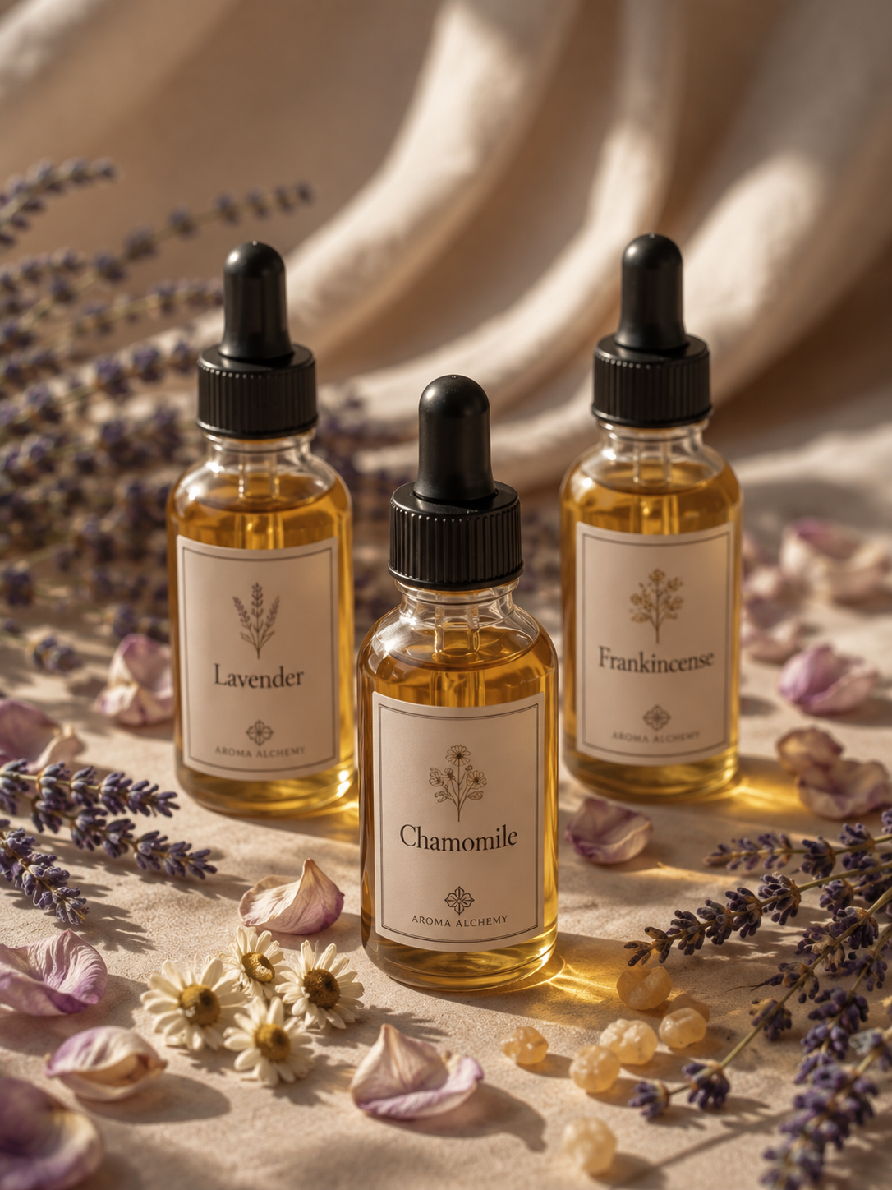



Crafted By Nature
Every Aroma Alchemy accessory uses natural lava stones infused with pure essential oils — chosen for their proven calming and restorative properties.
Lavender
Promotes deep relaxation and reduces anxiety
Chamomile
Soothes stress and encourages restful calm
Frankincense
Grounds the mind and creates a peaceful atmosphere

Slide 8
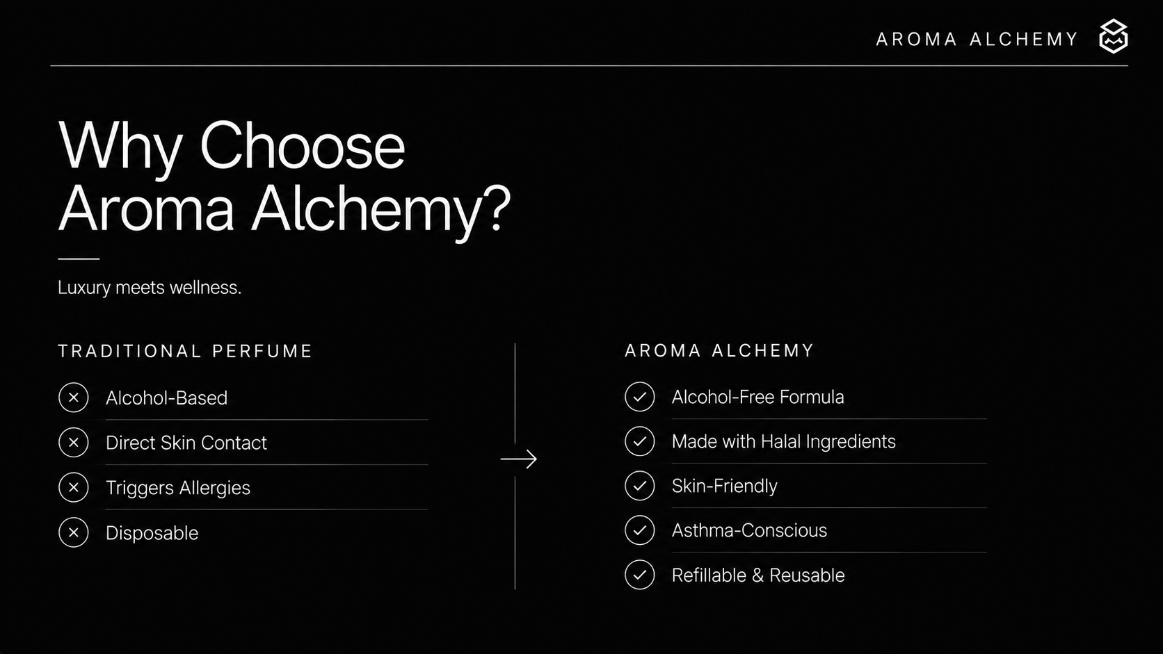
Aromatherapy Benefits
Luxury Meets Wellness
Wellness built in

Slide 9






More Than an Accessory
Aroma Alchemy stays with you — a gentle, comforting presence through every moment of your day.
Working
Studying
Traveling
Meditating
Relaxing

Slide 10
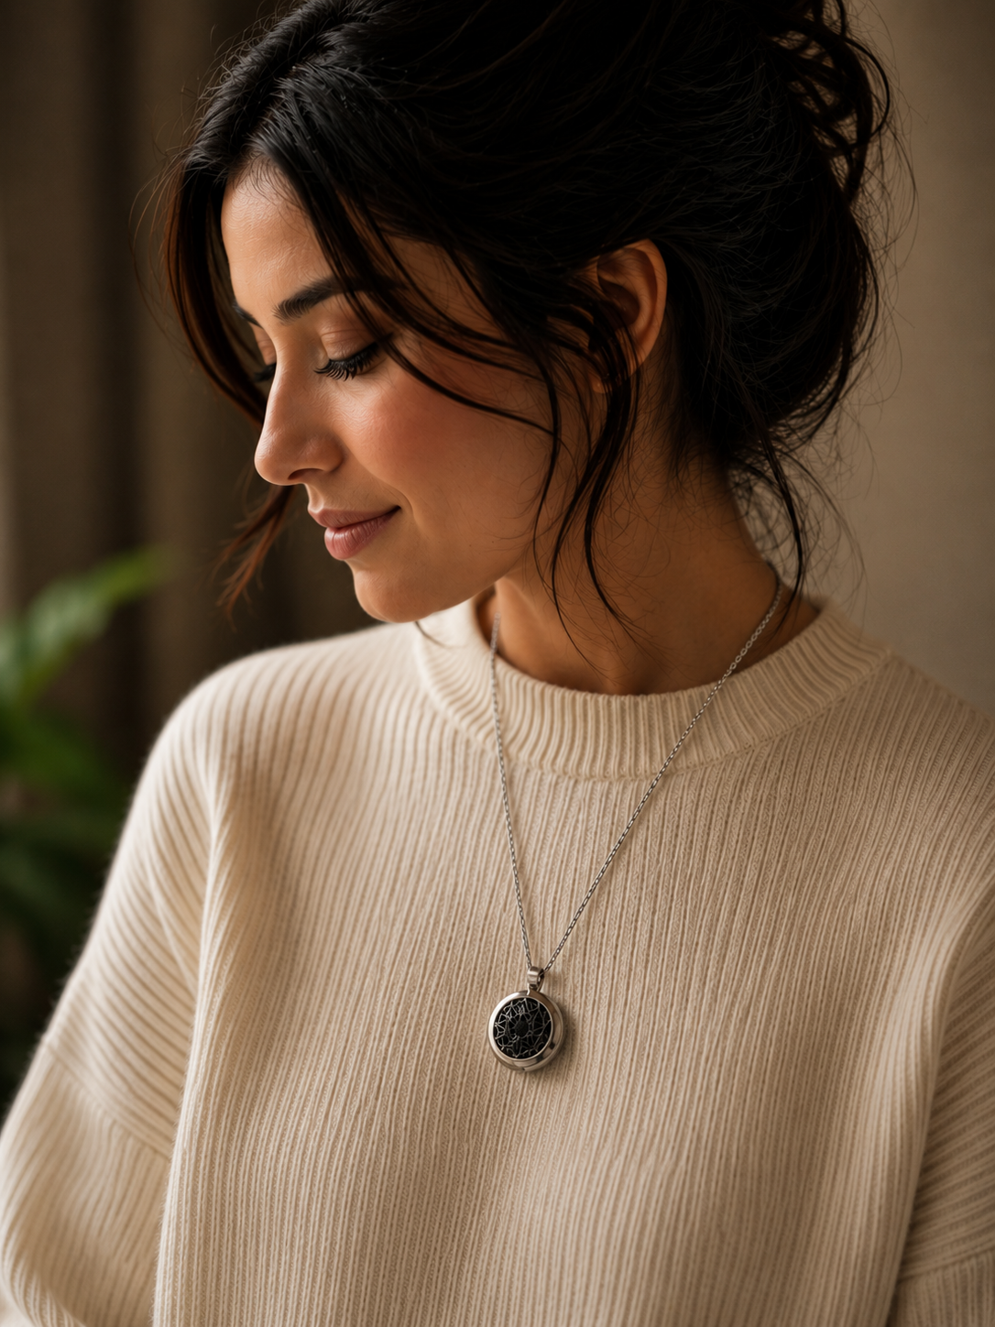



Real Stories
I've always avoided perfume because of my eczema. Aroma Alchemy finally gave me a way to wear my favorite scents without direct skin contact.
— Eiliyah Afroz
"My asthma made perfumes impossible. This is the first fragrance product I can comfortably wear."
— Office Professional
"Stylish, calming, and practical."
★★★★★
Aroma Alchemy — Wearable wellness for the modern life. Luxury without compromise.

Slide 11


Slide 12
